Slide 1
LEI 21-22 S4 2DC_3​
PROGRESS – SPRINT B
1 MAY 2022
Bárbara Pinto 1191507 | ​Carlos Dias 1200991​ | Cristóvão Sampaio 1201029 | ​ Miguel Silva 1201045​ | Martim Maciel 1201154

Slide 2
SUMMARY – Project Phases
WEEK 1
Project Structuring and Domain Class Implementation
WEEK 2
Development of User Stories without dependencies (create categories/products, create customers, upload warehouse plant)
WEEK 3
Realization of the remaining User Stories

Slide 3
PLANNING - PROJECT
1

Slide 4
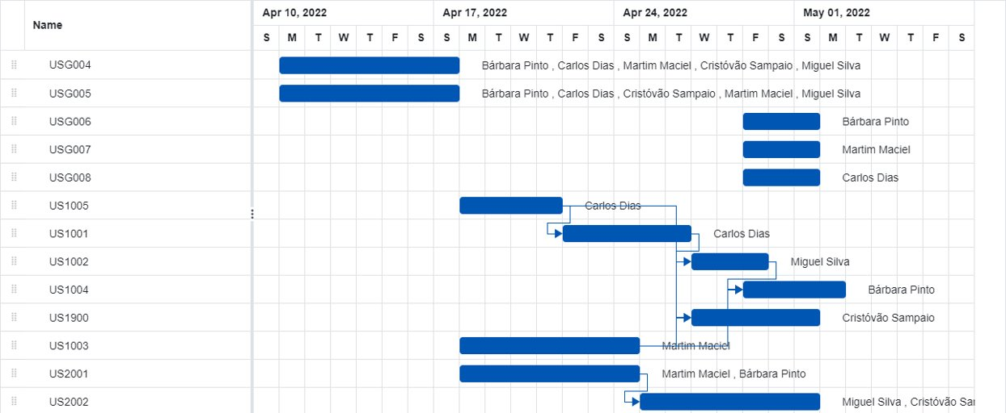

Slide 5
PLANNING - MEMBERS
2

Slide 6
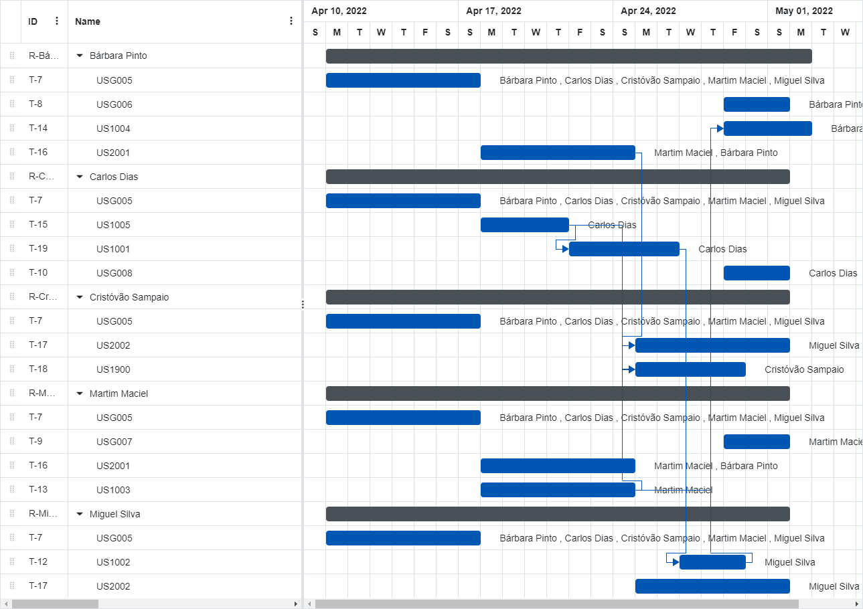

Slide 7
CONCLUDED ACTIVITIES – PROJECT MANAGEMENT
US​ | Description​ | Assignee​ | Baseline​ | Actual​ | Status​
[USG004] As Project Manager, I want the team to configure the project structure to facilitate / accelerate the development of upcoming user stories.​
USG004-1​ | Configure Warehouse domain classes.​ | Miguel Silva​ | Start: 11-04-2022​ End: 17-04-2022​ | Start: 18-04-2022​ End: 23-04-2022​ | ✔️
USG004-2​ | Configure AGV domain classes.​ | Cristóvão Sampaio​ | Start: 11-04-2022​ End: 17-04-2022​ | Start: 19-04-2022​ End: 25-04-2022​ | ✔️
USG004-3​ | Configure Order/Shopping Cart domain classes.​ | Bárbara Pinto​ | Start: 11-04-2022​ End: 17-04-2022​ | Start: 15-04-2022​ End: 22-04-2022​ | ✔️
USG004-4​ | Configure Product domain classes.​ | Carlos Dias​ | Start: 11-04-2022​ End: 17-04-2022​ | Start: 17-04-2022​ End: 19-04-2022​ | ✔️
USG004-5​ | Configure Customer domain classes.​ | Martim Maciel​ | Start: 11-04-2022​ End: 17-04-2022​ | Start: 18-04-2022​ End: 24-04-2022​ | ✔️
[USG005]​ | As Project Manager, I want the team to review the business model concepts (Domain Model).​ | All team members​ | Start: 11-04-2022​ End: 17-04-2022​ | Start: 14-04-2022​ End: 24-04-2022​ | ✔️
[USG006]​ | As Project Manager, I want the team to prepare a Glossary document.​ | Bárbara Pinto​ | Start: 29-04-2022​ End: 01-05-2022​ | Start: 01-05-2022​ End: 01-05-2022​ | ✔️
[USG007]​ | As Project Manager, I want the team to prepare a Class Diagram document.​ | Martim Maciel​ | Start: 29-04-2022​ End: 01-05-2022​ | Start: 30-04-2022​ End: 30-04-2022​ | ✔️
[USG006]​ | As Project Manager, I want the team to prepare a Glossary document.​ | Carlos Dias​ | Start: 29-04-2022​ End: 01-05-2022​ | Start: 30-04-2022​ End: 30-04-2022​ | ✔️

Slide 8
CONCLUDED ACTIVITIES – PROJECT IMPLEMENTATION
US​ | Description​ | Assignee​ | Baseline​ | Actual​ | Status​
US1001​ | As Sales Clerk, I want to specify a new product for sale.​ | Carlos Dias​ | Start: 21-04-2022​ End: 26-04-2022​ | Start: 21-04-2022​ End: 28-04-2022​ | ✔️
US1002​ | As Sales Clerk, I want to view/search the products catalog.​ | Miguel Silva​ | Start: 26-04-2022​ End: 28-04-2022​ | Start: 27-04-2022​ End: 29-04-2022​ | ✔️
US1003​ | As Sales Clerk, I want to register a new customer.​ | Martim Maciel​ | Start: 18-04-2022​ End: 24-04-2022​ | Start: 26-04-2022​ End: 29-04-2022​ | ✔️
US1004​ | As Sales Clerk, I want to create a new products order on behalf of a given customer.​ | Bárbara Pinto​ | Start: 28-04-2022​ End: 01-05-2022​ | Start: 29-04-2022​ End: 01-05-2022​ | ✔️
US1005​ | As Sales Clerk, I want to define a new category of products.​ | Carlos Dias​ | Start: 18-04-2022​ End: 21-04-2022​ | Start: 20-04-2022​ End: 23-04-2022​ | ✔️
US2001​ | As Warehouse Employee, I want to set up the warehouse plant by uploading a JSON file.​ | Bárbara Pinto​ | Start: 18-04-2022​ End: 24-04-2022​ | Start: 25-04-2022​ End: 30-05-2022​ | ✔️
 |  | Martim Maciel​
US2002​ | As Warehouse Employee, I want to configure the AGVs available on the warehouse.​ | Cristóvão Sampaio​ | Start: 25-04-2022​ End: 01-05-2022​ | Start: 29-04-2022​ End: 01-05-2022​ | ✔️
 |  | Miguel Silva​
US1900​ | As Project Manager, I intend that, for demonstration purposes, the system has the possibility of being initialized (bootstrap) with some information.​ | Cristóvão Sampaio​ | Start: 27-04-2022​ End: 01-05-2022​ | Start: 28-04-2022​ End: 29-04-2022​ | ✔️

Slide 9
IN PROGRESS/TO DO ACTIVITIES
US​ | Description​ | Assignee​ | Baseline​ | Actual​ | Status​
US1503​ | As a Customer, I wish to receive e-mail/SMS notifications from the system when I register my account or fulfill an order.​ | Bárbara Pinto​ | Start: 02-05-2020​ End: 11-05-2020​ | Start:​ End:​ | 🟡
 |  | Martim Maciel​
US1903​ | As Project Manager, I want the Payment and Shipment services associated with the Orders to be mocked for demonstration purposes.​ | Bárbara Pinto​ | Start: 02-05-2020​ End: 11-05-2020​ | Start: ​ End: ​ | 🟡

Slide 10
SYSTEM AND PRODUCT DELIVERY
SYSTEM OBJECTIVES
Provide proof of concept and minimum functionality​
» Register a product and respective category​
» Register a customer​
» Register an order​
» Load warehouse layout from file​
» Register and assign AGVs​
Guarantee data persistence (in-memory and on a local database)​
Provide initialization data to demonstrate system functionalities​
PRODUCT QUALITY
Quality metrics:
» 82% Class coverage ✔️
» 73% Method coverage ✔️
» 76% Line coverage​ ✔️
Stable build:
» runs outside development environment (IDE)
» runs in remote machines and multiple OS​
Achievements:
» Product catalog UI design
» In-memory implementation success​
​

Slide 11
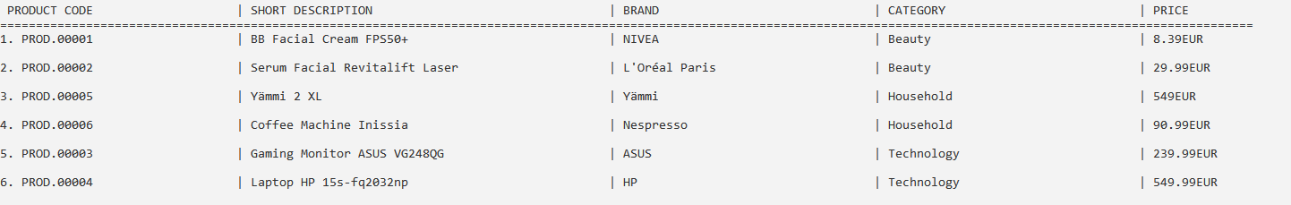
SYSTEM AND PRODUCT DELIVERY

Slide 12


TEAM WORK AND PLANNING
DEVELOPMENT PROCESS AND PLANNING
» Scrum/Agile methodology​
» JIRA software for task and sprint management​
» Planning based on priority (for time allocation) and user story complexity (for team member allocation)​
TEAM WORK AND CONFLICT SOLVING
» Team daily communication through Discord server and dedicated channels​
» Biweekly sprint status reports during EAPLI and LAPR4 PL classes​
» The team considers the work was balanced and communication effective​
​

Slide 13
LEI 21-22 S4 2DC_3​
PROGRESS – SPRINT B
1 MAY 2022
Bárbara Pinto 1191507 | ​Carlos Dias 1200991​ | Cristóvão Sampaio 1201029 | ​ Miguel Silva 1201045​ | Martim Maciel 1201154

